Slide 1
Self-Supervised Learning in Video
常瑞恒
前沿交叉学科研究院

Slide 2
Self-supervised learning
Robustness
Auxiliary task
Can be applied to both Image and Video

Slide 3
Video
A temporal sequence of frames
What can we use to define a proxy loss?
Nearby (in time) frames are strongly correlated
Temporal order of the frames
Motion of objects (via optical flow)

Slide 4
Shuﬄe and Learn: Unsupervised Learning using Temporal Order Veriﬁcation
Ishan Misra, C. Lawrence Zitnick, Martial Hebert

Slide 5
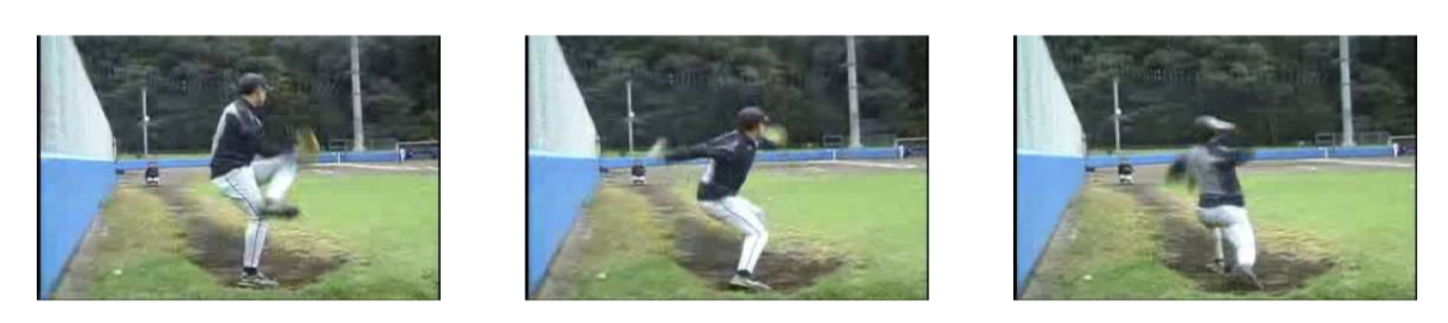
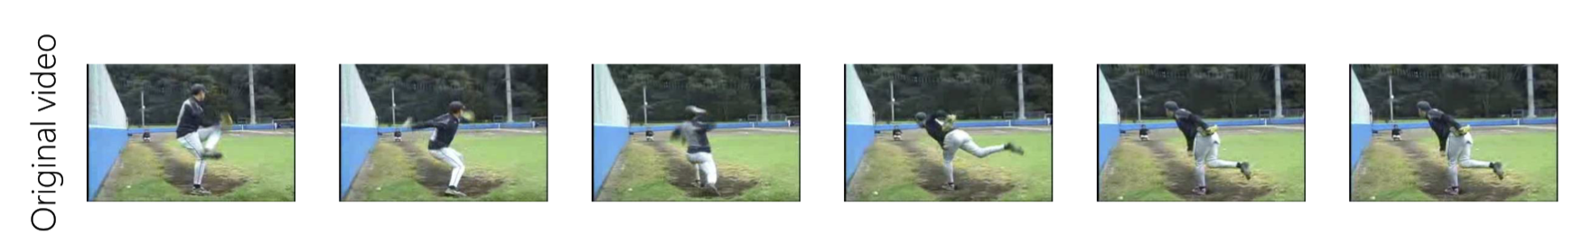
Sequential Verification
Is this a valid sequence?

Slide 6
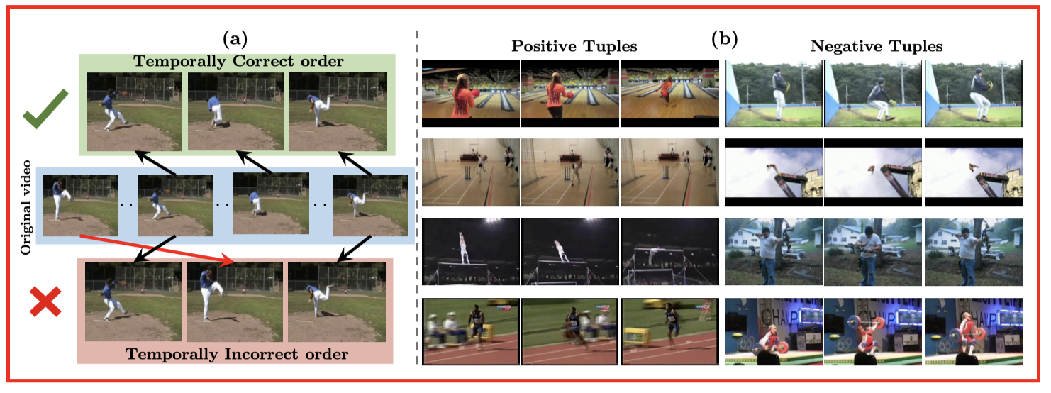

Slide 7
Task Motivation
learn a visual representation from the raw spatiotemporal signals in videos
we determine whether a sequence of frames from a video is in the correct temporal order
encourage the model to reason about the motion and appearance of the objects, and thus learn the temporal structure of videos

Slide 8
How many frames are needed to determine a correct answer?
two frames?
May be ambiguous
E.g. picking up a coﬀee cup or placing it down.

Slide 9
Tuple sampling
To reduce such ambiguity, we propose sampling a three frame tuple.
A naive method may sample the tuples uniformly from a video.
For frames with very little motion?

Slide 10
In temporal windows with very little motion it is hard to distinguish between a positive and a negative tuple.
we only sample tuples from temporal windows with high motion

Slide 11
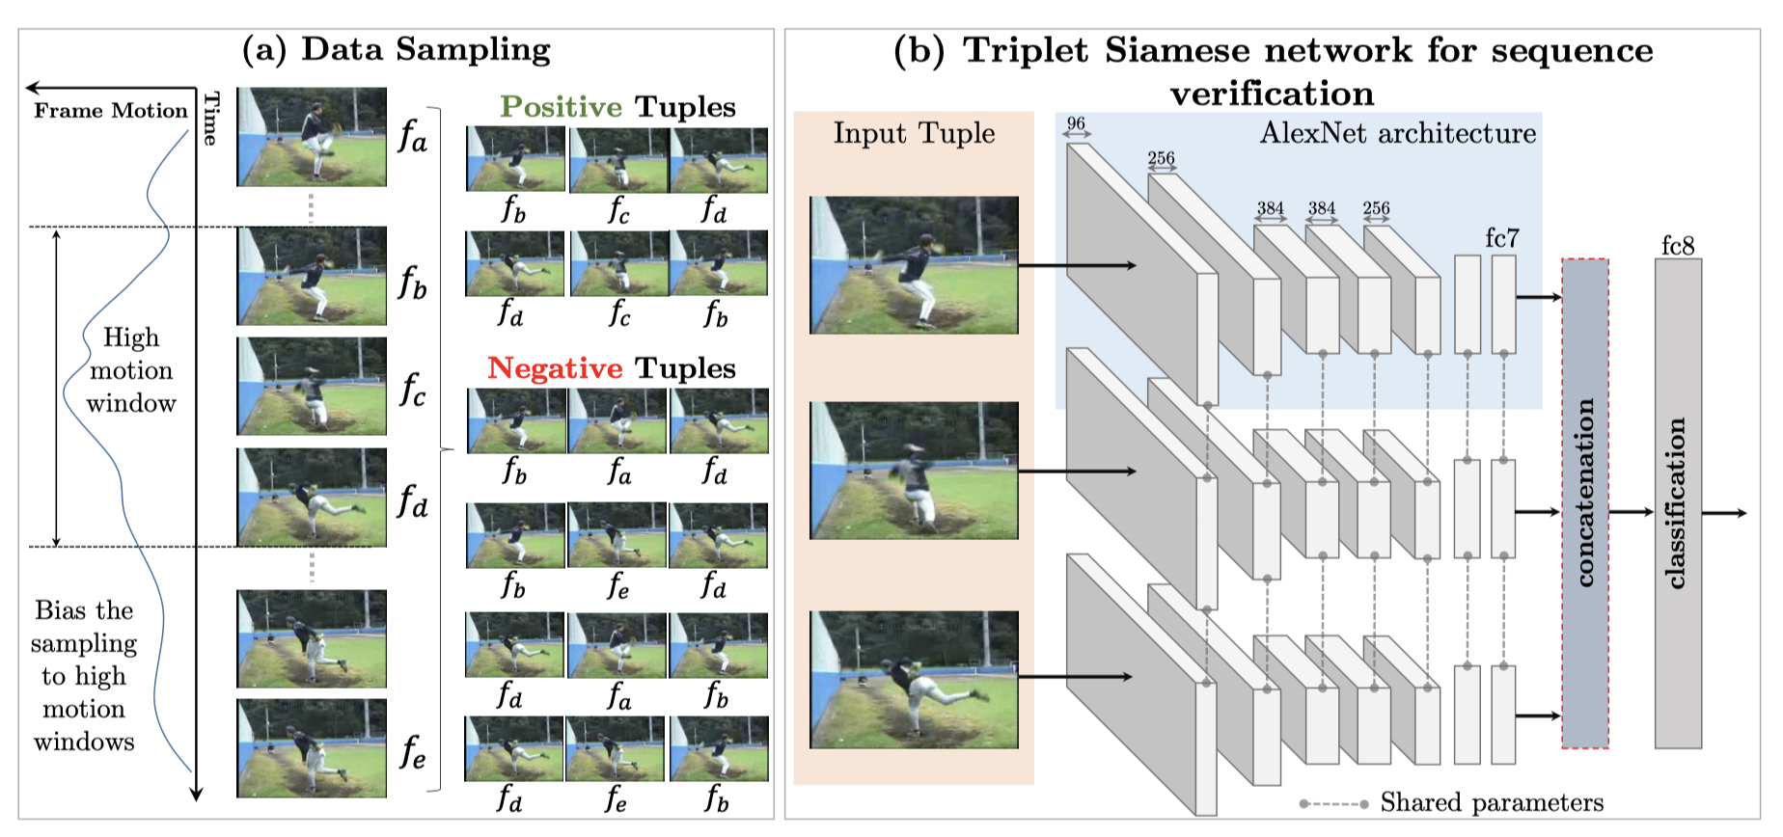
Architecture

Slide 12
three parallel network stacks with shared weights upto the fc7 layer.
Each stack takes a frame as input, and produces a representation at the fc7 layer.
The concatenated fc7 representations are used to predict whether the input tuple is in the correct temporal order.

Slide 13
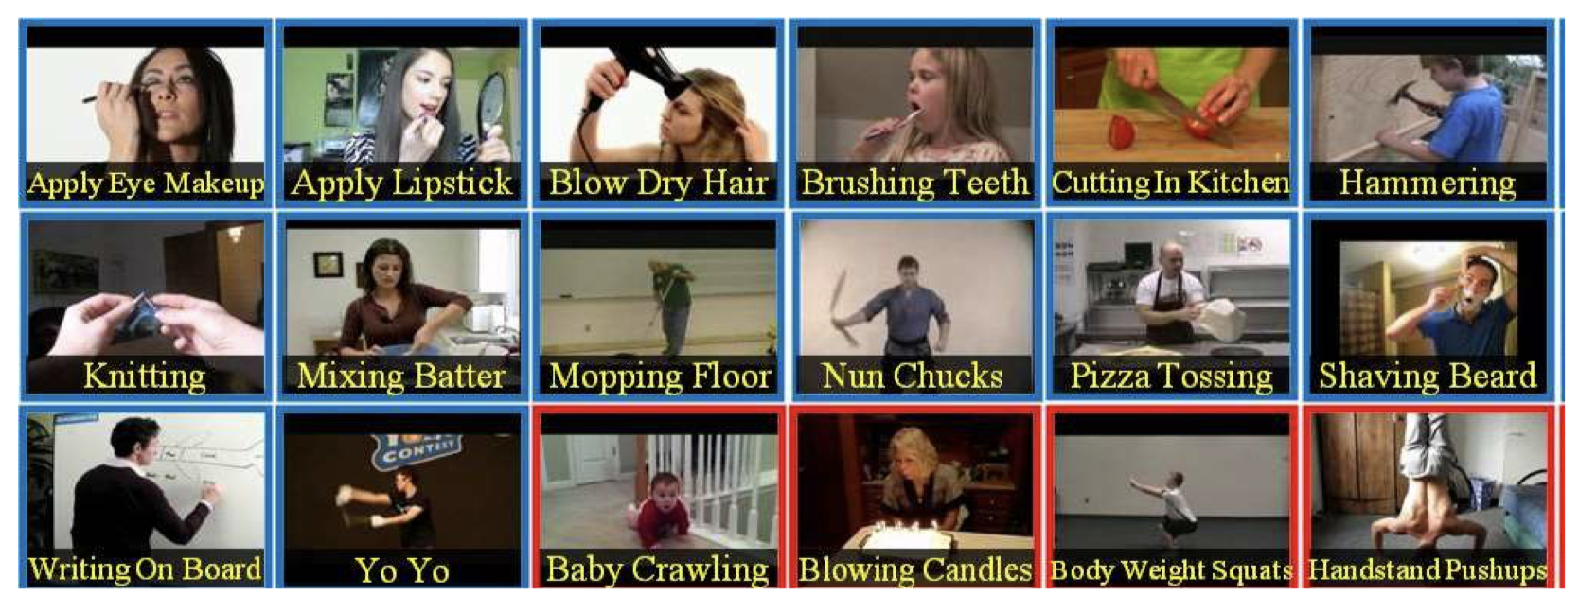
Experiment
Dataset: UCF-101 Action Recognition

Slide 14
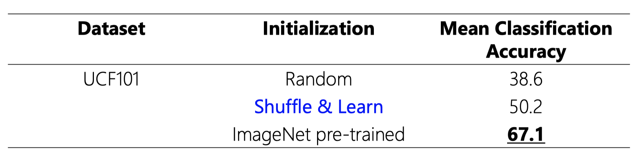
Result

Slide 15
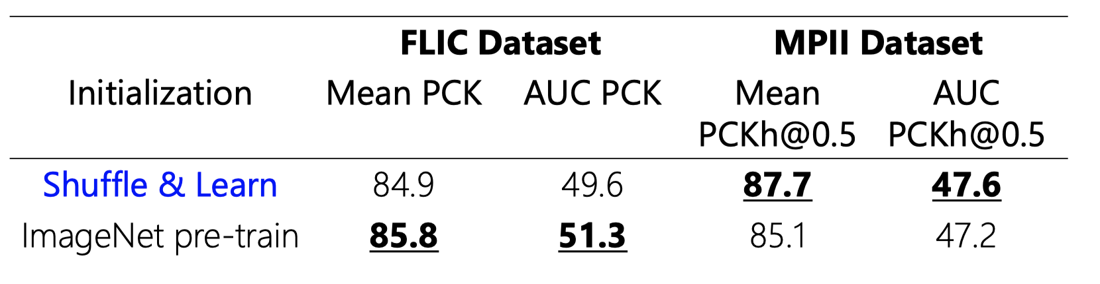
Keypoint estimation using FLIC and MPII Datasets

Slide 16
Conclusion
Show a signiﬁcant boost in accuracy over learning CNNs from scratch with random initialization.
Even outperforms pre-training with some supervised training datasets.

Slide 17
Learning and Using the Arrow of Time
Nasim Rahaman, Steffen Wolf, Anirudh Goyal, Roman Remme, Yoshua Bengio

Slide 18
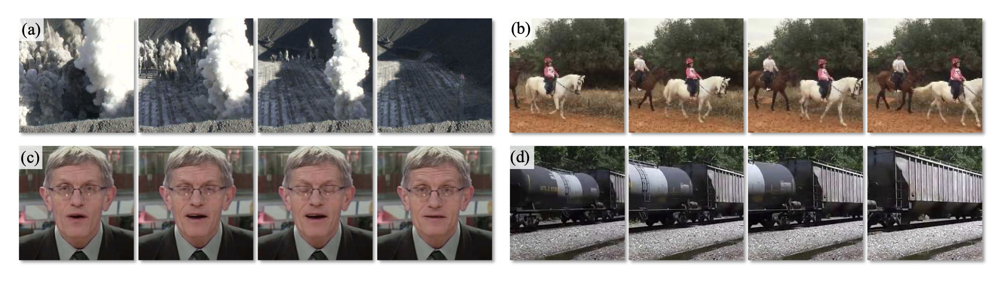
Task
predict if video playing forwards or backwards

Slide 19
Supervision
Positive training samples: video clips playing forwards
Negative training samples: video clips playing backwards

Slide 20
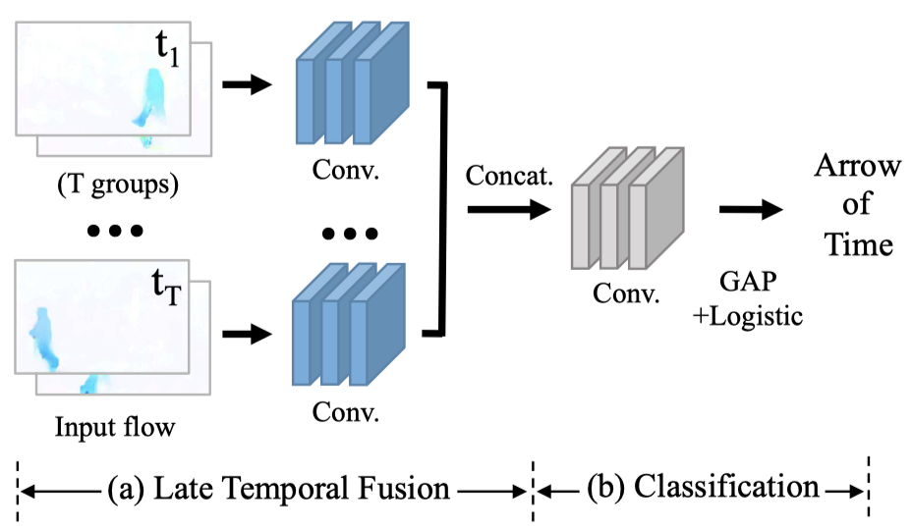
Temporal Class-Activation Map Network

Slide 21
Avoiding Artiﬁcial Cues from Videos
A learning-based algorithm may “cheat” and solve the arrow-of-time task using artiﬁcial cues, instead of learning about the video content.
Three main cues
black framing
camera motion
inter-frame codec

Slide 22
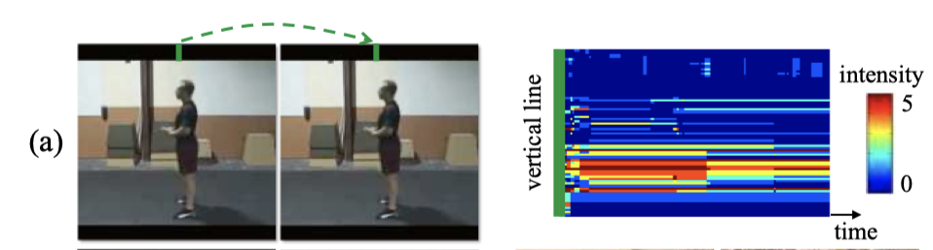
Black frame
Black frame regions present at the boundary may not be completely black after video compression

Slide 23
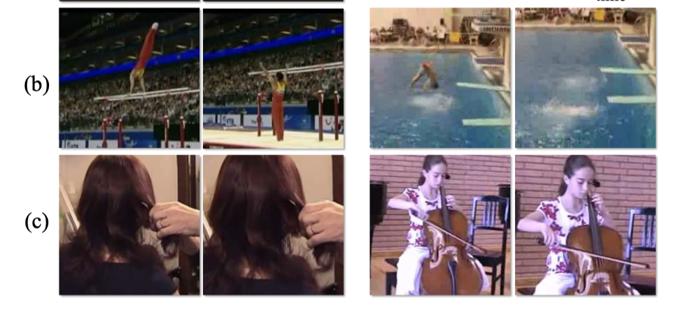
Camera motion

Slide 24
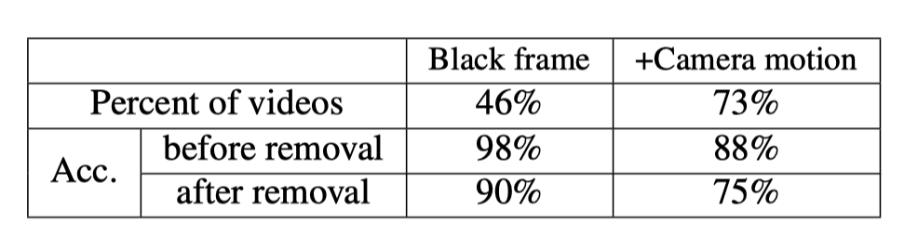
Remove artificial cues

Slide 25
Inter-frame codec
For efﬁcient storage, most online videos are compressed with temporally-asymmetric video codecs, e.g. H.264.
They often employ “Forward prediction”, which may offer an artiﬁcial signal for the direction of time.

Slide 26
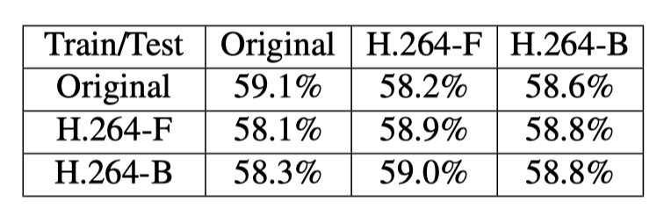

Slide 27
black framing and camera motion do allow our model to learn the artiﬁcial signals for the AoT prediction
the inter-frame codec (e.g. H.264) does not introduce signiﬁcant signals to be learned by our model.

Slide 28
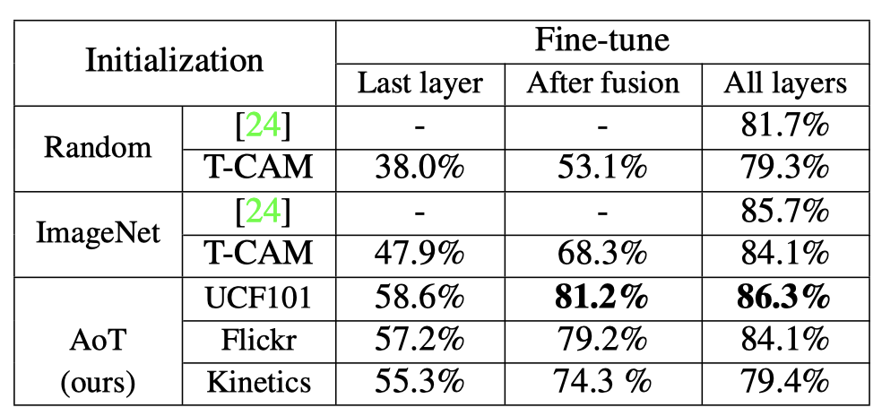
Action recognition on UCF101

Slide 29
Tracking Emerges by Colorizing Videos
Carl Vondrick, Abhinav Shrivastava, Alireza Fathi, Sergio Guadarrama, Kevin Murphy

Slide 30
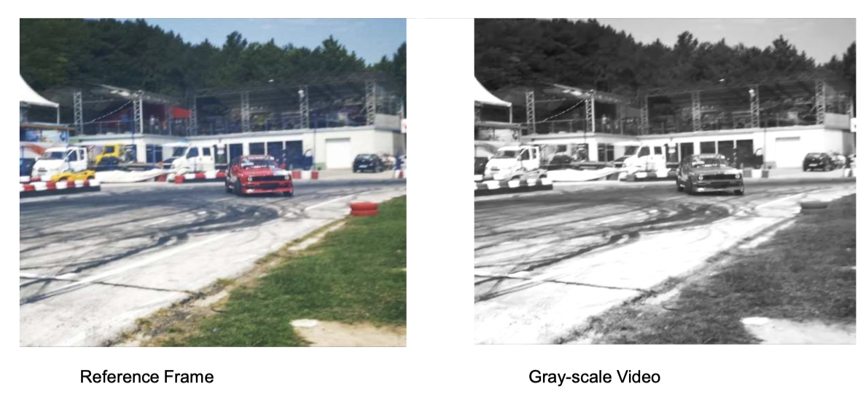
Task
given a color video, colorize all frames of a gray scale version using a reference frame

Slide 31
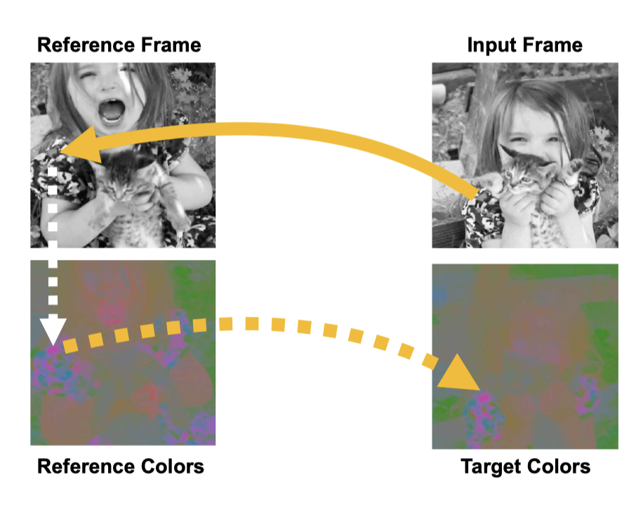
Colorize by Pointing
instead of trying to predict the color directly from the grayscale frame
we constrain the colorization model to solve this task by learning to copy colors from a reference frame

Slide 32
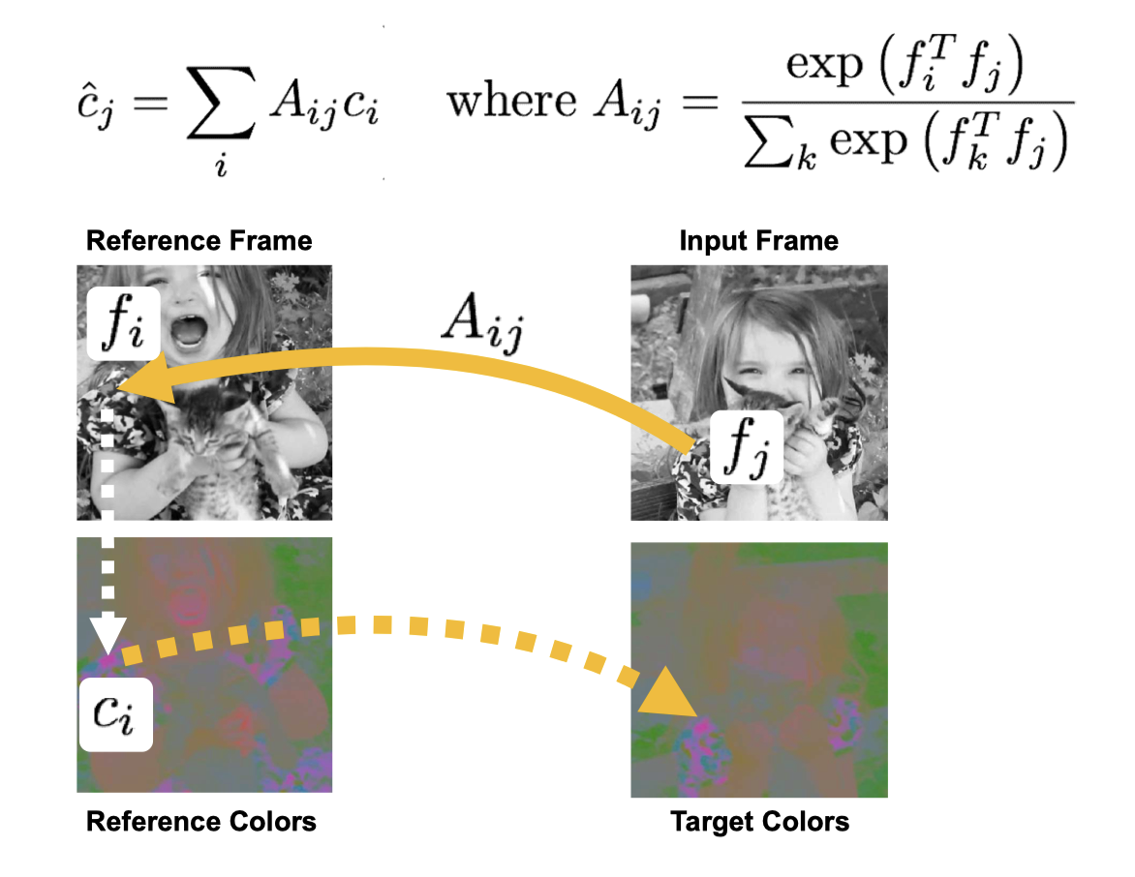
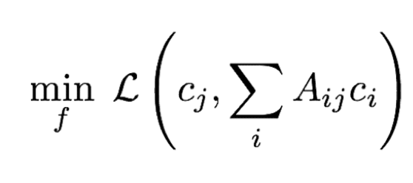
Model

Slide 33
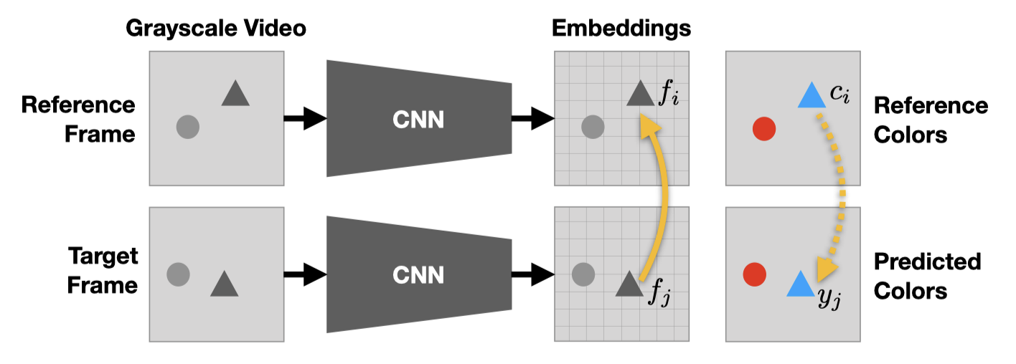
Model
After learning, we have a model that can compute a similarity matrix A for a pair of target and reference frames

Slide 34
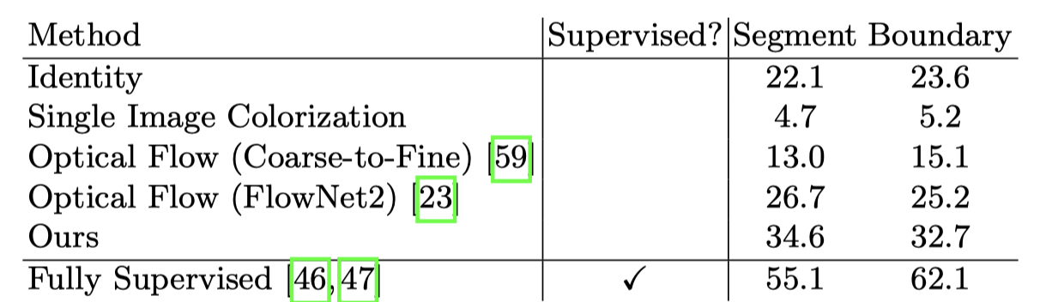
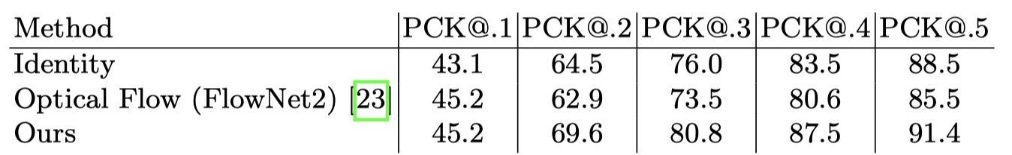
Experiment
Video Segmentation Results
Human Pose Tracking (no supervision)

Slide 35
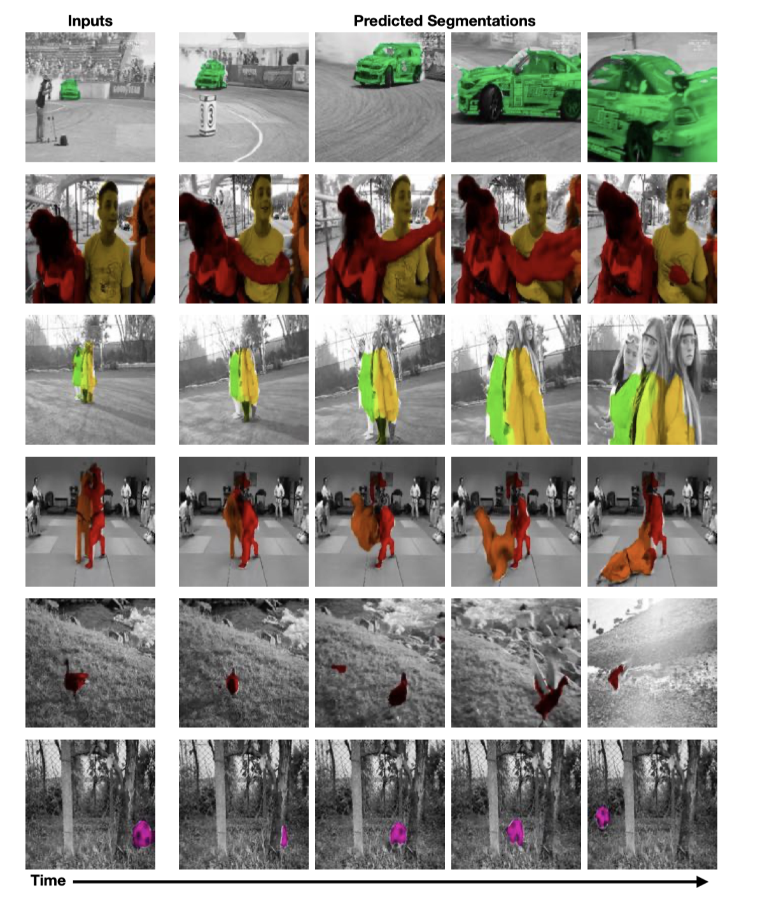

Slide 36
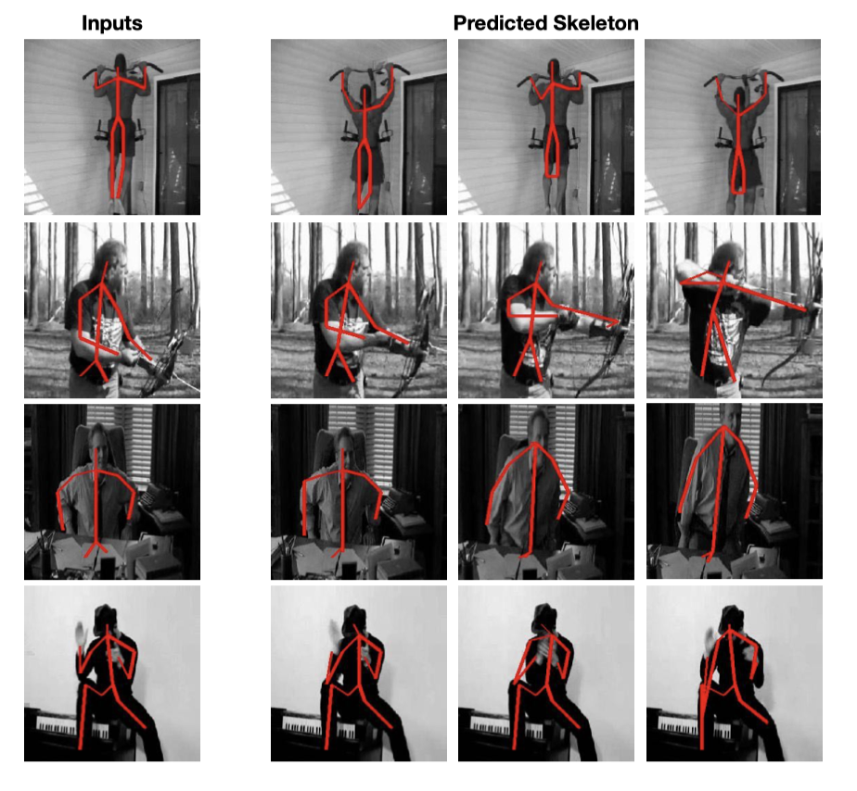

Slide 37
Joint-task Self-supervised Learning for Temporal Correspondence
Xueting Li, Sifei Liu, Shalini De Mello, Xiaolong Wang, Jan Kautz, Ming-Hsuan Yang

Slide 38
Visual Correspondence
two perspectives:
(a) learning region/object-level correspondences, via object tracking
(b) learning pixel-level correspondences between multi-view images or frames, e.g. optical ﬂow estimation

Slide 39
Motivation
pixels in a later frame can be considered as being copied from some locations of an earlier frame
learn a single afﬁnity matrix for modeling all inter-frame transformations through a network that learns appropriate feature representations that model the afﬁnity.

Slide 40
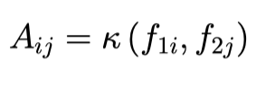
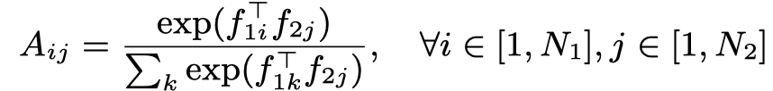
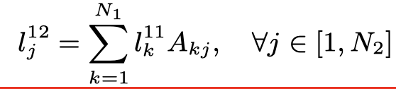
Model
$l_{j}^{mn}$ is the coordinate in frame m of jth pixel in frame n

Slide 41
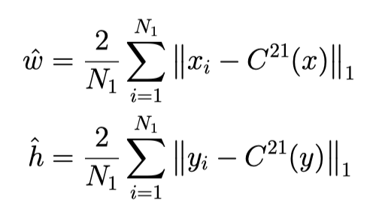
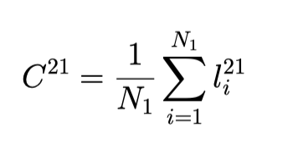
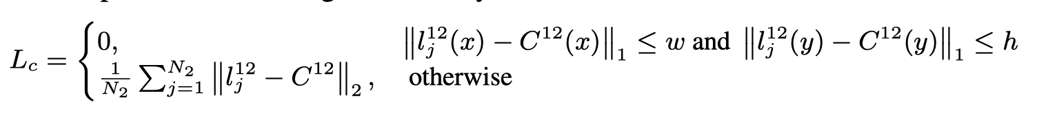
Region-level Localization
Moving as a unit.

Slide 42
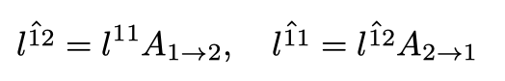
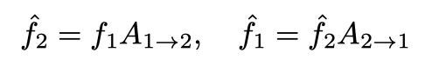
Fine-grained Matching
For a pair of patches, we encourage every pixel to fall into the same location after one cycle of forward and backward tracking
We use the MSE loss between $\hat{l^{11}}$ and $l^{11}$, $\hat{f_{1}}$ and $f_{1}$

Slide 43
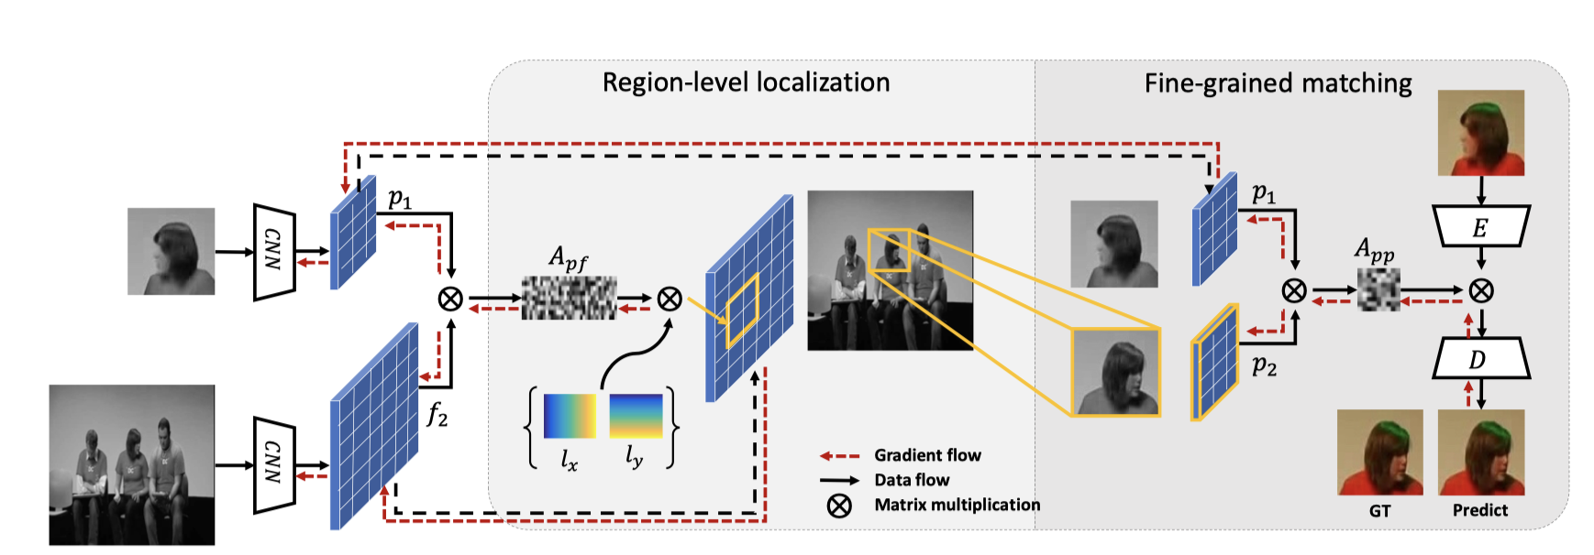

Slide 44
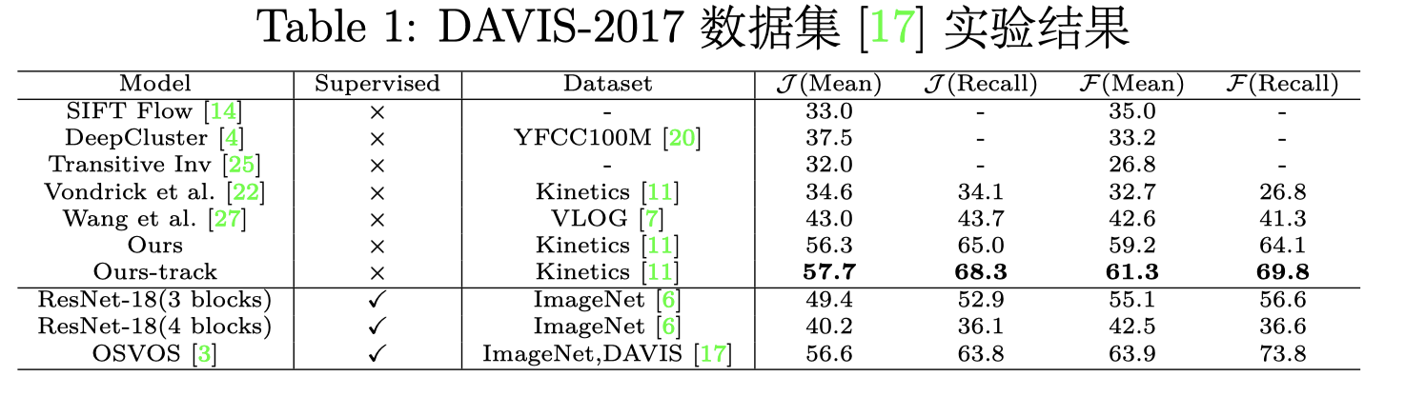
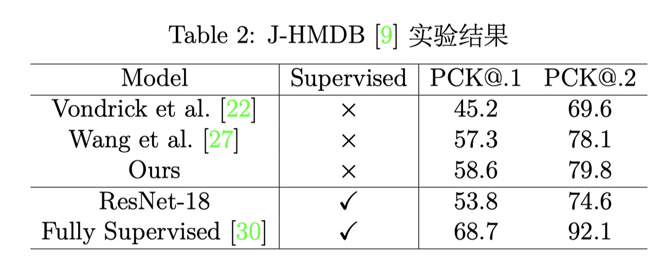
Experiment

Slide 45
Thanks!

